Slide 2
2017 SPONSORS

Slide 3
AWARDS UP FOR GRABS
MOST IMPROVED
MOST GOALS
COACH’S AWARDS
CHRISTOPHER ADAMS AWARD
IGOR & MIN BAJEV AWARD
BEST & FAIREST
TOP THAT!

Slide 4
MOST IMPROVED

Slide 5
MOST IMPROVED – C GRADE
ANGUS LUMSDEN

Slide 6
MOST IMPROVED – B GRADE
ADAM VAN DEN MUNCKHOF

Slide 7
MOST IMPROVED – A GRADE
DANIEL NICHOLSON

Slide 8
MOST GOALS

Slide 9
MOST GOALS – C GRADE
3RD – J.AYRIS (11)
FROM 9 GAMES
2ND – N.SHARP (22)
FROM 7 GAMES

Slide 10
MOST GOALS – C GRADE
WINNER
MATTHEW WHITE (33)
FROM 14 GAMES

Slide 11
CRAIG GINN AWARD – B GRADE
3RD – L.COOK (25)
FROM 13 GAMES
2ND – J.JOHANNSEN (26)
FROM 13 GAMES

Slide 12
CRAIG GINN AWARD – B GRADE
WINNER
MATT BARMBY (54)
FROM 18 GAMES

Slide 13
MICHAEL KALLESKE AWARD – A GRADE
3RD – D.NICHOLSON (41)
FROM 10 GAMES
2ND – S.CURRIE (45)
FROM 18 GAMES

Slide 14
MICHAEL KALLESKE AWARD – A GRADE
WINNER
JOSH GIDDINGS (47)
FROM 17 GAMES

Slide 15
COACH’S AWARDS

Slide 16
COACH’S AWARD – C GRADE
ALEX MARTIN

Slide 17
COACH’S AWARD – B GRADE
APOSTOLI KIKIANIS

Slide 18
COACH’S AWARD – A GRADE
JAYDEN FISCHER

Slide 19
CHRISTOPHER ADAMS MEMORIAL TROPHY ( A GRADE – BEST TEAM MAN)

Slide 20
THE CRITTER AWARD
1989 – 2015
#19

Slide 21
THE CRITTER AWARD WINNER
CHRIS ROWLANDS

Slide 22
IGOR & MIN BAJEV AWARD (RECOGNITION OF SERVICE TO THE CLUB)

Slide 23
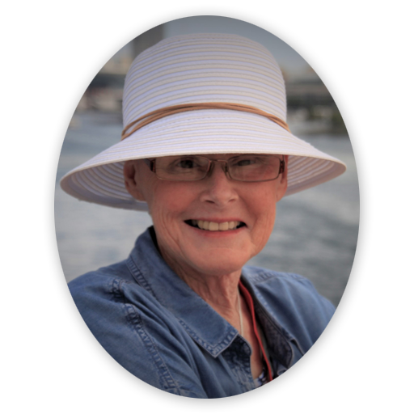
THE BAJEV AWARD
1953– 2017

Slide 24
THE BAJEV AWARD WINNER
MARK WILKINS
“WILKO”

Slide 25
BEST & FAIREST

Slide 26
LEADERBOARD AFTER 9 – C GRADE
A.GILES 46
Z.SIPEK 20
D.TRELOAR 18
J.TRIPODI 16
D.HODGSON 14
D.STYLES 14
J.AYRIS 14
C.COBURN 14
W.BURFORD 12
C.OLIVER 10

Slide 27
LEADERBOARD AFTER 12 – C GRADE
A.GILES 46
D.STYLES 24
Z.SIPEK 20
J.TRIPODI 20
D.TRELOAR 18
A.KNIGHT 16
D.HODGSON 16
N.SHARP 16
J.BORDON 14
C.COBURN 14

Slide 28
LEADERBOARD AFTER 15 – C GRADE
A.GILES 46
D.STYLES 28
J.BORDON 24
C.COBURN 22
Z.SIPEK 20
J.TRIPODI 20
D.TRELOAR 18
J.AYRIS 18
S.NOCK 16
A.KNIGHT 16

Slide 29
BEST & FAIREST WINNER - C GRADE
A.GILES 46
J.BORDON 32
D.STYLES 28
S.NOCK 28
B.JOHNTON 22
C.COBURN 22
Z.SIPEK 20
J.TRIPODI 20
D.TRELOAR 18
J.AYRIS 18

Slide 30
LEADERBOARD AFTER 9 – B GRADE
D.BALL 40
M.GURNETT 28
F.PORTEOUS 22
M.BARMBY 20
A.KIKIANIS 20
B.SANDERSON 18
J.KANE 16
A.PRIOR 14
A.MUNCKHOF 12
J.SIPEK 12

Slide 31
LEADERBOARD AFTER 12 – B GRADE
D.BALL 42
M.GURNETT 28
A.KIKIANIS 26
M.BARMBY 26
A.PRIOR 24
F.PORTEOUS 22
B.SANDERSON 18
J.JOHANNSEN 17
J.KANE 16
D.DUNN 16

Slide 32
LEADERBOARD AFTER 15 – B GRADE
D.BALL 42
M.BARMBY 36
M.GURNETT 28
A.KIKIANIS 26
A.PRIOR 24
D.DUNN 24
F.PORTEOUS 22
H.PRESTON 22
J.JOHANNSEN 21
C.COBURN 20

Slide 33
BEST & FAIREST WINNER – B GRADE
D.BALL 42
C.COBURN 38
M.BARMBY 36
A.PRIOR 34
M.GURNETT 32
A.KIKIANIS 28
D.DUNN 24
J.JOHANNSEN 23
F.PORTEOUS 22
H.PRESTON 22

Slide 34
2017 TEAM OF THE YEAR – D6
AS SELECTED BY
SA ADELAIDE FOOTBALLER
WILL JAMES (COACH)
DALTON TUCKER (RUCK)
JOSH GIDDINGS (HFF)
CHRIS SAMPSON (FB)
SHELDON CURRIE (INT.)

Slide 35
LEADERBOARD AFTER 9 – A GRADE
D.TUCKER 43
T.LAITY 30
J.GIDDINGS 21
C.SAMPSON 18
S.COOKE 18
T.MATTNER 18
N.TARCA 14
B.FRICK 13
D.NICHOLSON 12
H.CLEVELAND 12

Slide 36
LEADERBOARD AFTER 12 – A GRADE
D.TUCKER 54
T.LAITY 33
S.COOKE 28
D.NICHOLSON 22
J.GIDDINGS 21
H.CLEVELAND 21
B.FRICK 20
J.GROSSER 19
C.SAMPSON 18
T.MATTNER 18

Slide 37
LEADERBOARD AFTER 15 – A GRADE
D.TUCKER 64
S.COOKE 42
T.MATTNER 35
T.LAITY 33
H.CLEVELAND 31
J.GROSSER 25
D.NICHOLSON 22
B.FRICK 22
J.GIDDINGS 21
J.SIPEK 21

Slide 38
BEST & FAIREST WINNER – A GRADE
D.TUCKER 64
S.COOKE 54
T.MATTNER 51
T.LAITY 41
H.CLEVELAND 41
J.GIDDINGS 31
B.FRICK 26
J.GROSSER 25
J.SIPEK 23
D.NICHOLSON – A.FORBES – N.TARCA 22

Slide 39
STEVE MOY “TOP THAT!” AWARD

Slide 40
TOP THAT! AWARD
JOSH SIPEK
NOTE: IF YOU DON’T KNOW WHY JOSH RECEIVED
THIS AWARD THAT’S BECAUSE YOU’RE NOT MEANT TO!

Slide 41
THIS IS THE END OF THE AWARDS, BUT WHAT LIES AHEAD FOR THE PULTENEY FOOTBALL CLUB?

Slide 42
WHAT LIES AHEAD?
WE HAVE OFFICIALLY NOMINATED A SENIOR WOMEN’S SIDE FOR 2018
WE HAVE RENEWED OUR NOMINATIONS FOR 3x SENIOR MEN’S SIDES FOR 2018
WE ARE CLOSE TO ANNOUCING OUR COACHING STAFF ALONG WITH SEVERAL NEW RECRUITS FOR 2018
OUR AGM IS COMING UP NEXT MONTH (DATE TO BE CONFIRMED)
PRE-SEASON COMMENCES IN DECEMBER (DATE TO BE CONFIRMED)

